Slide 1
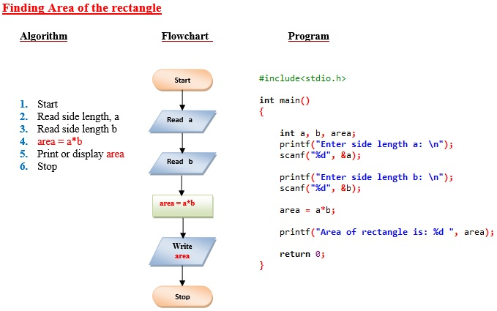
Computer Algorithms
An algorithm is a type of procedure or command independent of computer programmming languages that programmers use to write their codes to carry out tasks by a machine.
Krishna, G. (2020) Examples of algorithms and flowcharts in C, EngineersTutor. Available at: https://engineerstutor.com/2018/08/27/examples-of-algorithms-and-flow-charts-with-c-code/ (Accessed: February 13, 2023).

